Slide 1
Exploratory Data Analysis on Bank Loans
RANJITHA BABU B A

Slide 2
CONTENT
INTRODUCTION
PROBLEM STATEMENT
BUSINESS UNDERSTANDING
OBJECTIVE
UNDERSTANDING THE DATASET
DATA CLEANING
UNIVARIATE ANALYSIS
BIVARIATE / MULTIVARIATE ANALYSIS
CONCLUSION

Slide 3
INTRODUCTION
Solving this case study gives an idea of how real-life business problems are solved using EDA. In this case study, all the techniques learnt in EDA have been applied. A basic understanding of risk analytics in banking and financial services and understand how data minimizes the risk of losing money while lending it to customers is being understood.

Slide 4
PROBLEM STATEMENT
You work for a consumer finance company that specialises in providing various types of loans to urban customers. When the company receives a loan application, it has to decide whether to approve or reject it based on the applicant’s profile. Two types of risks are associated with the bank’s decision:
If the applicant is likely to repay the loan, then not approving the loan results in a loss of business to the company.
If the applicant is not likely to repay the loan, i.e., they are likely to default, then approving the loan may lead to financial loss for the company.
The aim is to identify patterns indicating that a person is likely to default, which may be used to deny the loan, reduce the loan amount, lend (to risky applicants) at a higher interest rate, etc.

Slide 5
BUSINESS UNDERSTANDING
When a person applies for a loan, there are two types of decisions that could be taken by the company:
Loan accepted: If the company approves the loan, there are three possible scenarios, as described below:
Fully paid: The applicant has fully paid the loan (the principal and the interest amount).
Current: The applicant is in the process of paying the instalments, i.e., the tenure of the loan is not yet completed. These candidates are not labelled as ‘defaulted’.
Charged-off: The applicant has not paid the instalments in due time for a long period, i.e., they have defaulted on the loan.
Loan rejected: The company had rejected the loan (because the candidate does not meet their requirements, etc.). Since the loan was rejected, there is no transactional history of those applicants with the company; so, this data is not available with the company (and thus, in this data set).

Slide 6
OBJECTIVE
This company is the largest online loan marketplace facilitating personal loans, business loans, and the financing of medical procedures. Borrowers can easily access lower interest rate loans through a fast online interface.
Like most other lending companies, lending to ‘risky’ applicants is the largest source of financial loss (called credit loss). Credit loss is the amount of money lost by the lender when the borrower refuses to pay or absconds with the money owed. In other words, borrowers who default cause the biggest losses to lenders. In this case, customers labelled as ‘charged-off’ are the ‘defaulters’.
If one is able to identify these risky loan applicants, then such loans can be reduced, thereby cutting down the amount of credit loss. Identification of such applicants using EDA is the aim of this case study.
In other words, the company wants to understand the driving factors (or driver variables) behind loan default, i.e., the variables which are strong indicators of default. The company can utilise this knowledge for its portfolio and risk assessment.

Slide 7
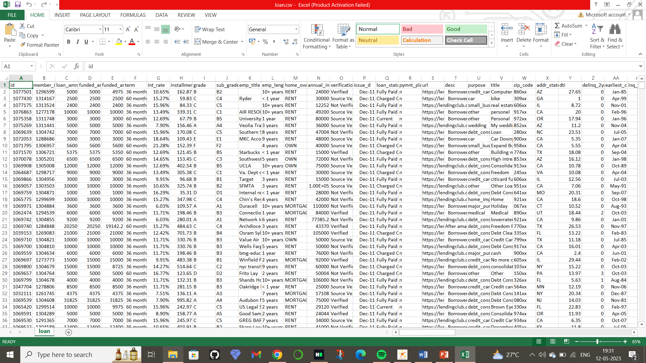
UNDERSTANDING THE DATASET
The data set has 39717 Rows and 111 Columns.
There are 54 Columns in which all the rows are Null .
Those 54 Columns should to be dropped.
In the Dataset 10 columns have Unique Values.
Two Columns have more than 90% Null Values.
Some column named have more then 50% Null values.

Slide 8
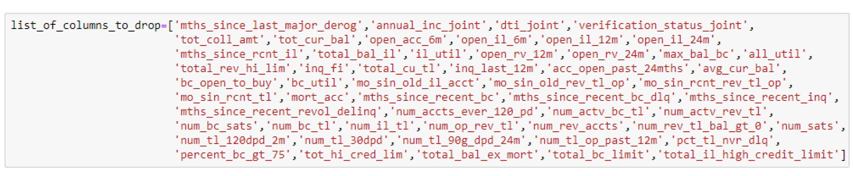

Data cleaning
Fig: List of columns to drop.
Fig: There are no duplicated rows in the dataset.

Slide 9
Data cleaning
The column Loan Status has three types of Values Fully Paid, Charged Off and Current. We don’t have use with the Current, so we are dropping the rows which has loan status as current.
The Column Employee Title has 2386 Null Values. Instead of filling it with mode I filled it as ‘Unknown’.
The same above process has been done with the Employee length column as well.
The Column ‘pub_rec_bankruptcies’ has 687 Null Value and we have no use with that column, so we are dropping that column.
The Column ‘last_pymnt_d’, ‘revol_util’ and 'last_credit_pull_d’ have less Number of null values, so the rows which have null values are dropped.

Slide 10
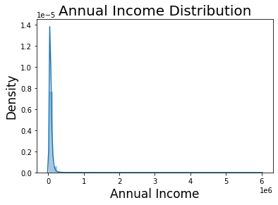
Data cleaning
The Interest rate is in the string format we have to convert it in to Float type.
The issue date is the format object so we have to covert it in to the datetime object.
The column annual income has outliers because mean is 68,835 and the maximum value is 6,00,000. So we need to remove those outliers. We can see in the figure how the annual income was spread before removing outliers and after removing outliers.

Slide 11
UNIVARIATE ANALYSIS
Univariate analysis is perhaps the simplest form of statistical analysis. Like other forms of statistics, it can be inferential or descriptive. The key fact is that only one variable is involved.

Slide 12
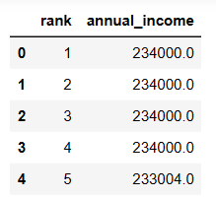
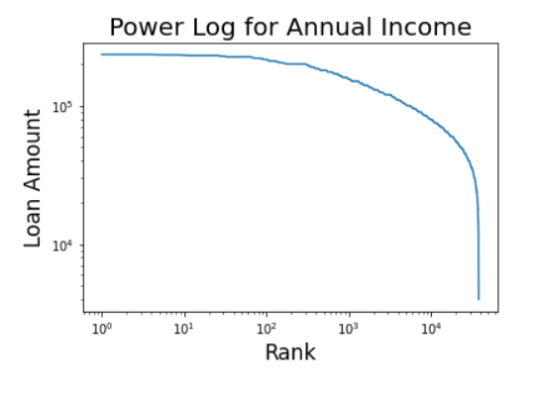
Univariate analysis
Annual Income
We can see the power log graph for the Annual Income,
from that graph we can say that most people have
almost same range of income.

Slide 13
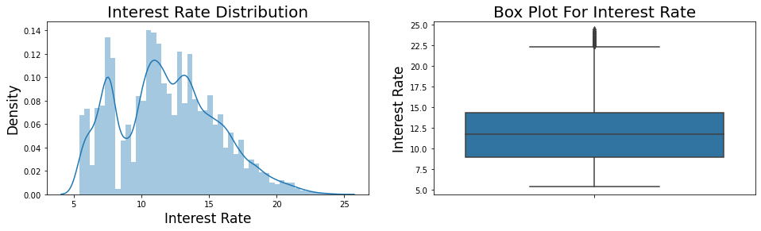
Univariate analysis
2. Interest rate
We can infer that most people took loans at a rate of interest in the range of 10 to 15.

Slide 14
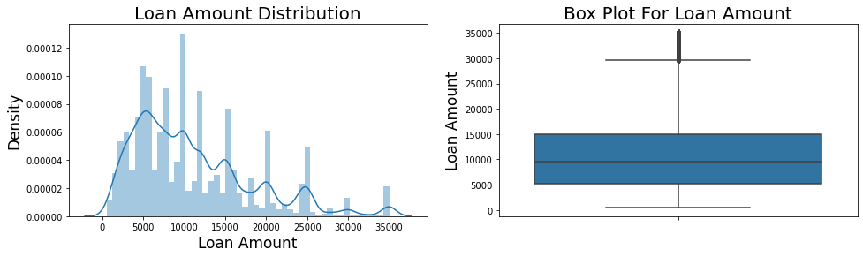
Univariate analysis
3. Loan amount
We can see that the loan amount is spread evenly and the median of the loan amount lies in the range of 5000 - 10000.

Slide 15
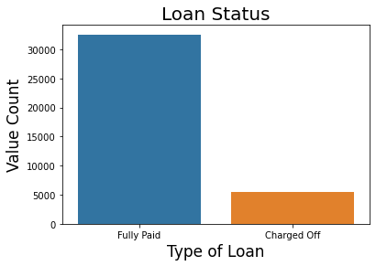
Univariate analysis
4. Loan Status
We can infer that the Dataset has mostly
the list of people whose Loan Status is
Fully Paid compared to the Charged-Off.

Slide 16
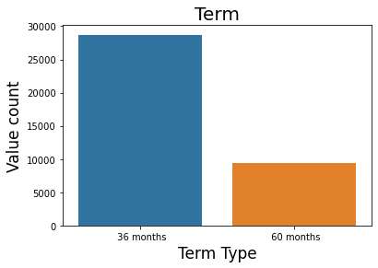
Univariate analysis
5. Term
We can say that most people prefer to take a loan for a term of 3 years rather than that of 5 years.

Slide 17
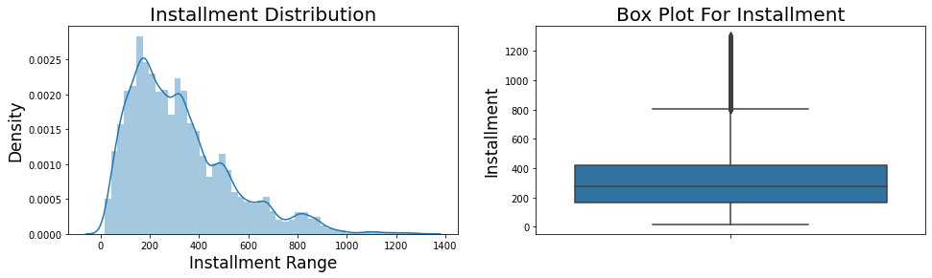
Univariate analysis
6. Installment
We can say that most people are paying the loan in installments in a range 150-350.

Slide 18
Bivariate/MULTIVARIATE analysis
Bivariate/Multivariate analysis are one of the simplest forms of quantitative (statistical) analysis. It involves the analysis of two variables (often denoted as X, Y) or more, for the purpose of determining the empirical relationship between them.

Slide 19
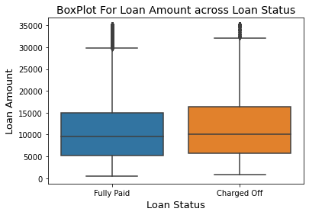
Bivariate/MULTIVARIATE analysis
Loan Status vs Loan Amount
We can say that the median of Loan Amount of charged-off people is high i.e. the people who are not paying the loan are taking more amount of money.

Slide 20
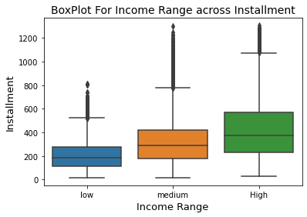
Bivariate/MULTIVARIATE analysis
2. Income Range vs Installment
We can see that the installment is rising with the increase in the Income Range.

Slide 21
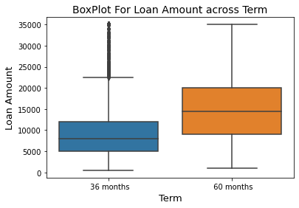
Bivariate/MULTIVARIATE analysis
3. Term vs Loan Amount
From the figure we can say that the average Loan Amount of people whose term is 5 years is comparatively more than that of 3 years.

Slide 22
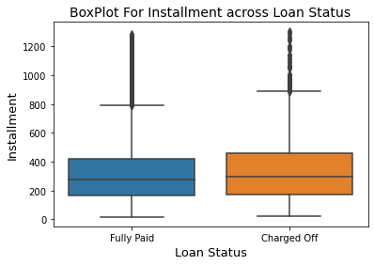
Bivariate/MULTIVARIATE analysis
Loan Status vs Installment
We can infer that the median of Installment of charged-off loans is slightly higher than the fully paid loans.

Slide 23
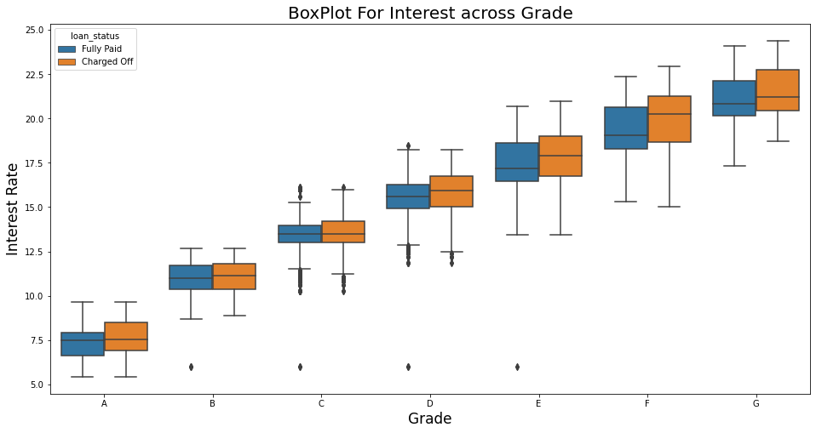
Bivariate/MULTIVARIATE analysis
5. Grade vs Interest Rate
It is observed that the median of Interest rate is gradually increasing from Grade A to G.

Slide 24
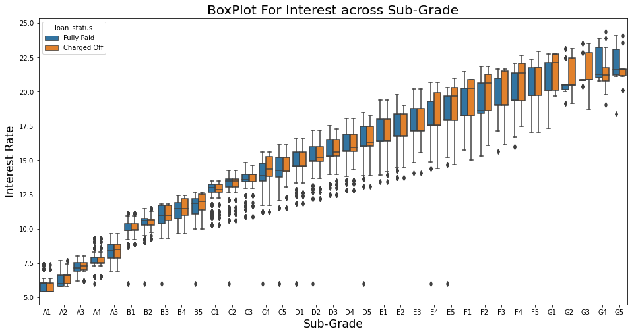
Bivariate/MULTIVARIATE analysis
6. Sub-Grade vs Interest Rate
The gradual increase in median of interest rate from A1 to G5 is shown more precisely.

Slide 25
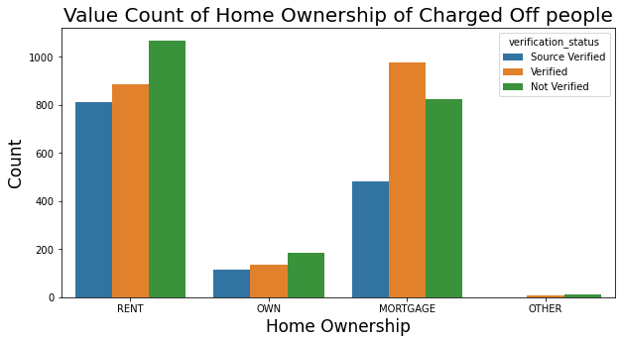
Bivariate/MULTIVARIATE analysis
7. Home ownership vs Loan Status
vs Verification Status
We can see that the people with an unverified RENT ownership and verified MORTAGE ownership are most likely to be charged-off from the loan.

Slide 26
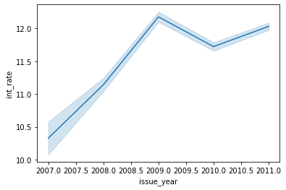
Bivariate/MULTIVARIATE analysis
8. Issued Year vs Interest Rate
From figure 15(line plot) we can see that after the steady increase of interest in the year 2007, the interest rate got decreased from 2009 to 2010. The main reason for this would be the Recession.

Slide 27
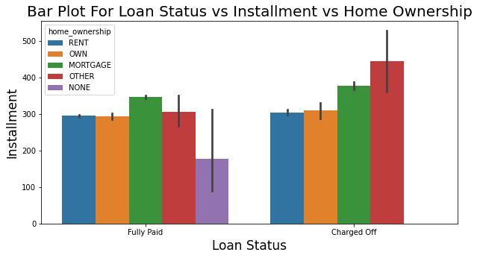
Bivariate/MULTIVARIATE analysis
9. Loan Status vs Installment vs
Home Ownership
We can say that in both the cases i.e. (Fully Paid and Charged Off), the Mortgage ownership people are paying the highest number of Installments.

Slide 28
CONCLUSION
In conclusion, Exploratory Data Analysis (EDA) is a powerful tool that can be used to analyze bank loan data to reduce or omit all possible risks.
By visualizing and analyzing the data, important insights can are extracted from the univariate, bivariate and multivariate analyses that can help ensure that loans are not rejected for applicants capable of repaying or are approved for applicants incapable of repaying.
EDA can help bankers better understand their clients' behavior and make more informed decisions about loan approvals.

Slide 29
THANK YOU

